Slide 1
HUMAN RESOURCES
BUSINESS FUNCTIONAL AREA

Slide 2
THE SME AND PEOPLE
DEFINITION OF HUMAN RESOURCES
ROLES OF A HR MANAGER
HUMAN RESOURCE PROCESSES
WHAT IS DIGITAL HR
THE CASE FOR DIGITAL HR
SELECTING A DIGITAL HR PLATFORM
HR MODULE: PROJECT
REFERENCES

Slide 3
DEFINITION OF HUMAN RESOURCES

Slide 4
HR DEFINITION
it is the process of managing people in organizations in a structured and thorough manner.
involves the focus on making the "employment relationship" fulfilling for both management and employees.
Human resources - Wikipedia
Human resource management is a managerial process of acquiring and engaging the required workforce, appropriate for the job and concerned with developing, maintenance and utilization of that workforce.
“HRM is concerned with the people dimension” in management.
Definition of Human Resource Management (economicsdiscussion.net)

Slide 5
ROLES OF A HUMAN RESOURCE MANAGER

Slide 6
ACTIVITIES PERFORMED BY HR MANAGER
Determine the needs of the staff/personnel.
Determine whether to use temporary staff or hire employees to fill these needs.
Determine do's & don'ts.
Recruit the best employees
Train employees and upgrade their learning knowledge.
Supervise the work.
Evaluate the work.
Establish 'Discipline work culture' in the organization.
Avoid politics in the office.
Apply 'HR Software' for the ease of work in the organization.
Manage employee relations. If there are unions, perform collective bargaining.
Prepare employee records and personal policies.

Slide 7
ACTIVITIES PERFORMED BY HR MANAGER
Manage employee payroll, benefits, and compensation.
Ensure equal opportunities.
Deal with discrimination.
Deal with performance issues.
Ensure that human resources practices conform to various regulations.
Motivate employees.
Mediate disputes.
Disseminate information in the organization so as to benefit its growth.
REFLECTION
WHAT KEY ASPECTS OF HR ARE MISSING FROM THIS LIST?
Human resources - Wikipedia

Slide 8
ACTIVITY
GROUP DISCUSSION
In your group, please list people related activities that you perform that are not on the list.
How much of your time do all your HR activities occupy
See how that compares with your colleagues in the group

Slide 9
HUMAN RESOURCE PROCESSES

Slide 10
RECRUITMENT
Recruitment is the process of attracting qualified candidates to interview with (and potentially work for) a company.
R specialists own all the necessary steps to recruit talent.
Includes posting jobs on sites such as Monster or Indeed and developing compensation packages that are likely to attract and retain the most talented candidates.
HR must also:
review each application,
determine the best fit,
conduct phone screens,
schedule (and sometimes conduct) formal interviews,
initiate background checks, and
draft initial offers.

Slide 11
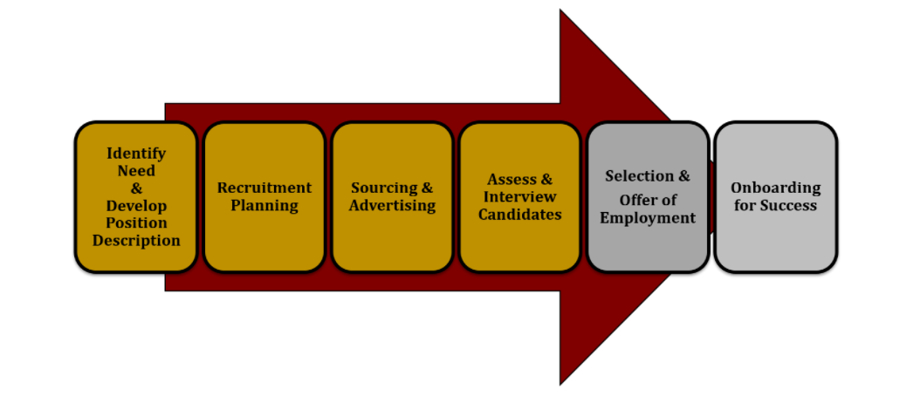
RECRUITMENT PROCESS

Slide 12
OTHER PROCESSES
Retention
Onboarding
Offboarding
Training and Development
Employee Relations
Compensation and Benefits
Employee requests
Performance management
Human Resource Planning
Regulatory compliance

Slide 13
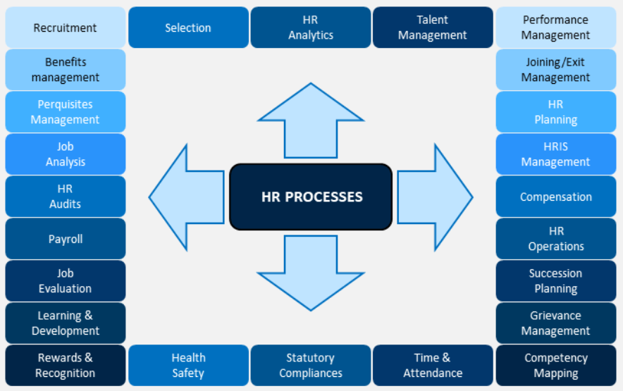
HUMAN RESOURCE PROCESSES

Slide 14
MY PEOPLE PROCESSES AND SOFTWARE
How many of the HR processes do you use in your business?
Can you please list them?
Do you think investing time in HR would be a waste of your effort?
Do you think investment in people should have a return on your bottom line?
In your business, would standardising HR processes help generate profits?
Do you use any software to conduct business?
Do you have access to an electronic device and a data connection?
If so, please specify what device and/or type of connection?
How many computers do you use in your business?
Are you comfortable working with a computer?

Slide 15
WHAT IS DIGITAL HR

Slide 16
DIGITAL STRATEGY
A digital strategy can be defined as: “a form of strategic management and a business answer or response to a digital question, often best addressed as part of an overall business strategy.”
HR digital transformation is the process of changing operational HR processes to become automated and data-driven.

Slide 17
DIGITISATION
Digitalization has played a crucial role, for small to large scale companies, amid the on-going pandemic.
from administration to execution professionals, every employee is being armed up with devices and software to keep track of work processes.
this has enabled businesses’ to function and collaborate internally using productivity tools and has helped improve operational efficiency with agile business continuity plans.

Slide 18
AUTOMATION
Given the current industry scenario and advancement in technology, HR solutions for automated employee onboarding and automated help desk are gaining traction in the market.
the remote working model and increased leverage of digital technologies have created the need to adapt and readapt the workforce to ensure the smooth functioning of the business.
entire hiring process is becoming virtual using intelligent assessment and video interview practices.

Slide 19
DATA COLLECTION
Data Collection & Mining Tool: To improve the nature of changes in the organization, the HR departments are using efficient data collection and mining tools. This will and has enabled the organization to adopt tools that help track how employees’ feel to drive business, work, perform and collaborate to improve operations and efficiency. Further, with the integration of advanced AI capabilities with Data Collection and Mining Tools, HR will be able to deliver actionable insights for informed and faster decision making.
Article: The back-to-the-office challenge: How it affects the HR specialists – People Matters (peoplemattersglobal.com)

Slide 20
PROCESS AUTOMATION
Effective HR departments drive organizational objectives by managing HR processes but can compromise growth by using manual methods.
Repetitive, multi-step tasks and manual interactions among tools are highly prone to human errors and inefficiencies that delay time to action.
Automation and integration can eliminate those risks, giving HR teams more time to focus on other priorities.
The result is an HR team that can visualize all processes in a single place, prioritize important demands and manage its responsibilities while putting employees first.

Slide 21
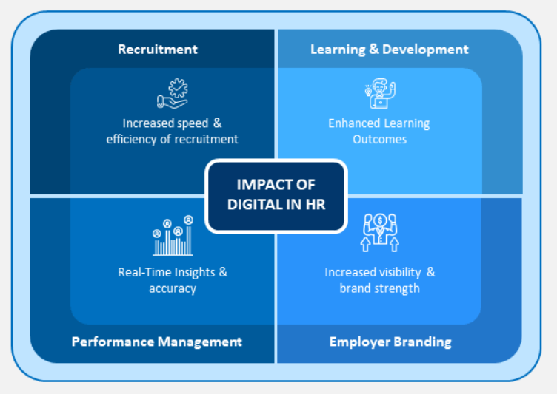
DIGITAL HUMAN RESOURCES

Slide 22
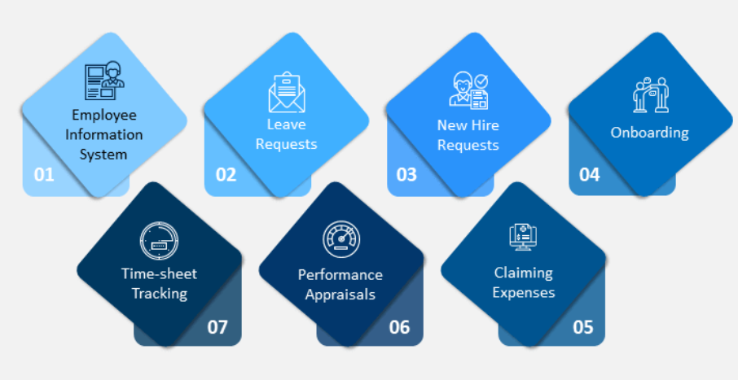
HR PROCESSES AMENABLE TO AUTOMATION

Slide 23
ACTIVITY
GROUP ACTIVITY
Choose an online HR system, either Bamboo, Zoho or Merlin HR
Create a free profile for your business
Ask your tutor any questions you may have about the functionality of the software.

Slide 24
THE CASE FOR DIGITAL HR

Slide 25
PEOPLE NOT PAPER
Successful HR managers know that it’s their job to take care of people, not just paperwork. After all, employees are your business’ most valuable asset.
Employees happiness and well-being have a direct impact on customer satisfaction, process efficiency, and business profitability.
HR process automation and integration allows you to shift your focus away from the minutiae of forms, emails, and spreadsheets and toward making a meaningful impact for the people in your organization.
HR service delivery is built on four foundational pillars:
people,
process,
technology and
governance.

Slide 26
PEOPLE NOT PAPER
In the HR organization of the future, each of these pillars must evolve to allow the organization to adapt to the new external environment and the ever-changing needs of the customer.
From a people perspective, organizations need to upskill their resources and shift to more agile, iterative ways of working.
The agile HR organization will be underpinned by integrated governance structures that bring HR, Finance and IT together to cohesively monitor and meet the needs of the business.
Real-time, integrated data and analytics will be critical to enable decision-making. But before HR can make this shift, organizations need to establish a strong technology and process layer.

Slide 27
COMMON APPLICATIONS
Paperless operation : Emails & Microsoft Office, benefit claims, leave applications, and other miscellaneous items requiring efforts in tracking and organization.
Employee self-service app e.g. use of Mobile apps
Automation : Billing, medical claim process, cashless transactions using digital platforms.
Recruiting through social media : Use of LinkedIn
Training : Unless its mandatory online platforms like TEAMS, Google meet or a cloud based training system can be employed to provide training.

Slide 28
THE NEW WORKFORCE
Contingent Workforce/Gig Economy: Contingent workers (freelancers, contractors, consultants, temps) increased 56% since 2006 and made up almost half of the American workforce in 2017.
Millennials: More than 1 in 3 American workers are Millennials (ages 18-34) as of 2015, surpassing GenX workers for the first time.
Mobility: By 2020 mobile workers will account for nearly three-quarters (72.3%) of the U.S. workforce.

Slide 29
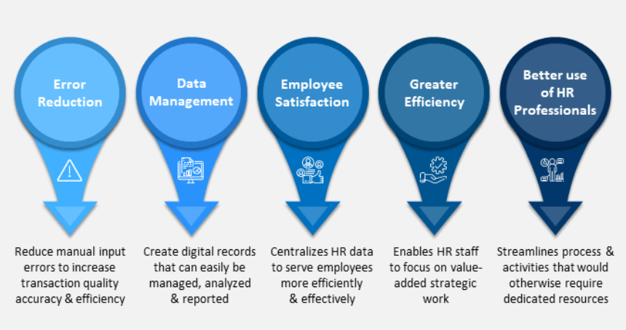
BENEFITS OF DIGITISATION ON HR
HR Processes PowerPoint Template | SketchBubble

Slide 30
SELECTING A DIGITAL HR PLATFORM

Slide 31
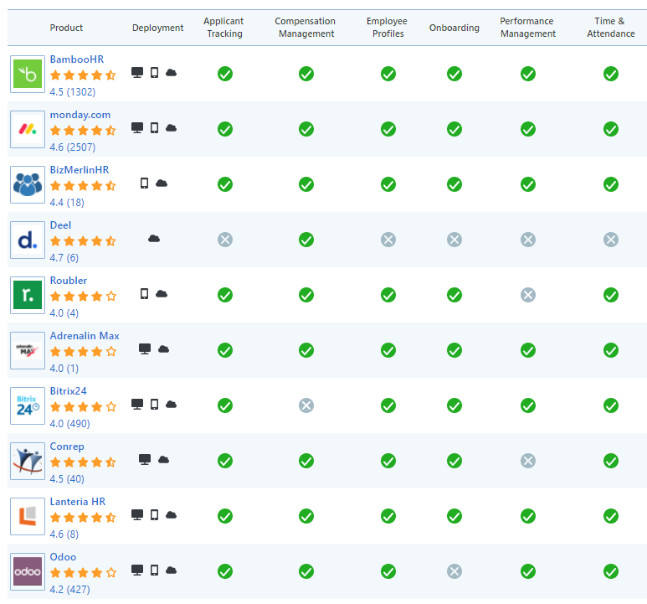
HR SOFTWARE

Slide 32
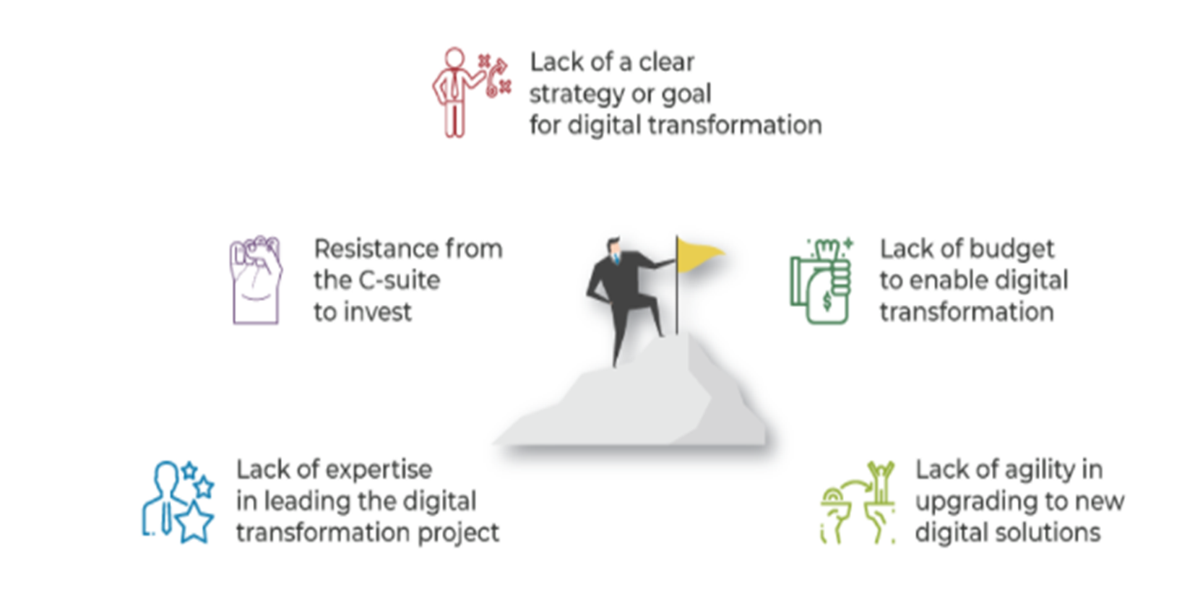
BARRIERS TO DIGITAL ADOPTION

Slide 33
ACTIVITY
GROUP ACTIVITY
Submit your organisational structure as it appears on software platform

Slide 34
REFERENCES

Slide 35
REFERENCES
The Complete Guide to Human Resources For Small Business https://wheniwork.com/blog/what-is-human-resources
Managing Human Resources in Small and Entrepreneurial Firms. https://slideplayer.com/slide/4253088/
Digitization of Human Resources, 2018. https://www.slideshare.net/WillYen2/digitization-of-hr-slideshare-kenny-company-2018-pdf-version
Nyamubarwa, W., & Chipunza, C. (2019). Debunking the onesize-fits-all approach to human resource management: A review of human resource practices in small and medium-sized enterprise firms. SA Journal of Human Resource Management/SA Tydskrif vir Menslikehulpbronbestuur, 17(0), a1108. https://doi.org/ 10.4102/sajhrm.v17i0.1108
Human Resource Management System (HRMS) http://www.ibizmyanmar.com/human-resource-management-system-hrms/
Change Made in Shop Floor Management to Transform a Conventional Production System into an “Industry 4.0” http://dx.doi.org/10.1109/ICITM.2018.8333919
HR Digitalisation Practices https://healthmetrics.com/m/10-hr-digitalisation-practices-that-you-can-implement-right-away/
Mazzarol, Tim and Reboud, Sophie, (2020), Small Firms and Human Resources, ch. 7, p. 229-275, Springer, https://EconPapers.repec.org/RePEc:spr:sptchp:978-981-13-9509-3_7

